Slide 1


Department of Computer Science and Engineering
TASK MANAGEMENT SYSTEM
WEB PROGRAMMING PROJECT
NAME: MRIDHULA DEVI M
REG NO: 240701337

Slide 2
ABSTRACT
The Task Management System is a web-based application designed to simplify task creation, assignment, tracking, and status management. It provides separate access for administrators and team members, with real-time notifications to improve team communication and productivity.

Slide 3
PROBLEM STATEMENT
Managing tasks through manual methods or scattered communication can lead to missed deadlines, unclear responsibilities, and poor task tracking. A centralized system is needed to efficiently assign tasks, monitor progress, and keep team members updated in real time.

Slide 4
LITERATURE SURVEY
Existing task management systems provide basic features such as task creation, assignment, tracking, and status updates.
Many systems use centralized databases and traditional request-response communication.
Existing solutions may lack real-time notifications for task assignments and status changes.
There is a need for a simple system that combines role-based task management, real-time updates, and cloud-based data storage.

Slide 5
PROPOSED WORK
Develop a web-based Task Management System for administrators and team members.
Administrators can create, assign, monitor, update, and delete tasks.
Team members can view assigned tasks and update their task status.
Implement JWT authentication, MongoDB Atlas, and WebSockets for secure access, cloud storage, and real-time notifications.

Slide 6
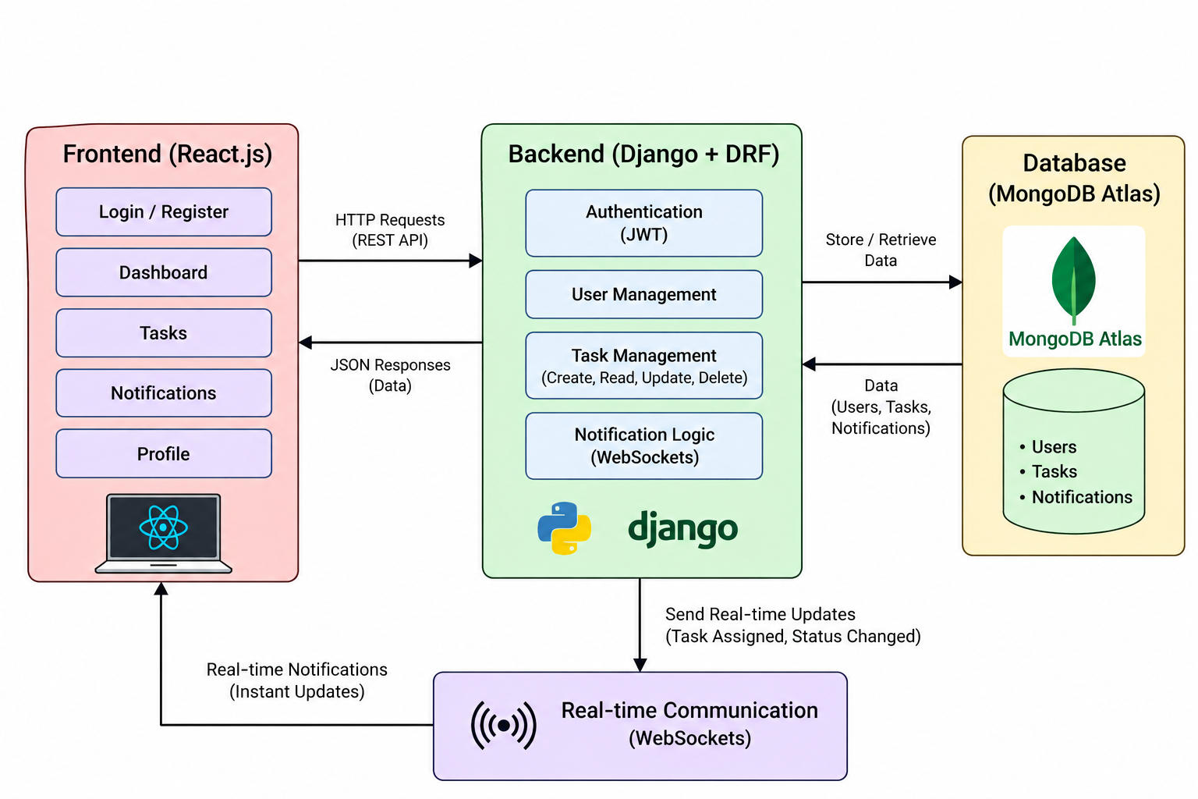
SYSTEM ARCHITECTURE

Slide 7
CONCLUSION
The proposed system provides a centralized platform for managing team tasks efficiently.
Role-based access helps separate administrator and team-member responsibilities.
Real-time notifications improve communication about task assignments and updates.
The system can be further enhanced with task analytics, reminders, deadlines, and advanced reporting.

